Slide 1
Travel Management SYSTEM
Submitted by
Pranav Singh(201500497)

Slide 2
INTRODUCTION
We have tried our best to make the complicated process of Design and Development of Web Based Travel Management System as simple as possible using Structured & Modular technique & Menu oriented interface.This Project is used bt two types of users:
Online user and
Administrator(management of the travel).

Slide 3
PURPOSE
The main purpose of my exercise is perform each Employee’s activity in computerized way rather than manually which is time consuming:
The Entire activity is to automate the process of day to day activities of Travel like
Travel activities very safely,
Assign a transport according to customer’s choice of a computer and
Releasing to their destination and finally compute the bill in short time.

Slide 4
Existing Features
“Travel Management System”has been designed to computerize the following functions that are performed by the system:
Travel Detail Functions
picking and droping Functions
Destination Details

Slide 5
System Facilities
Booking a transport online add up long before guest’s arrival.
Guests can read reviews and compare prices for Online travel Booking.
The most important advantage of online travel booking is convenience.
Internet helps people to browse through the place around the world and compare the facilities and rates easily.

Slide 6
SOFTWARE REQUIREMENTS
System development software
Operating System : Windows 10,11
Development platform : XAMPP, Sublime
Language: HTML, CSS, PHP
Server: SQL, phpMyAdmin
Stylesheet : CSS
Browse: Chrome, Microsoft edge

Slide 7
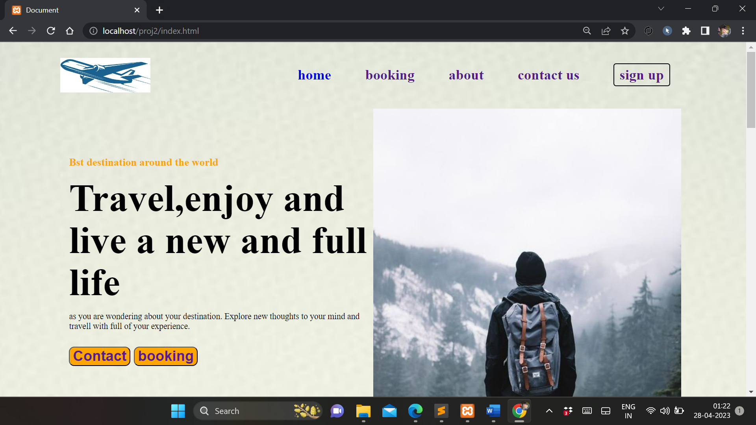
HOME PAGE

Slide 8
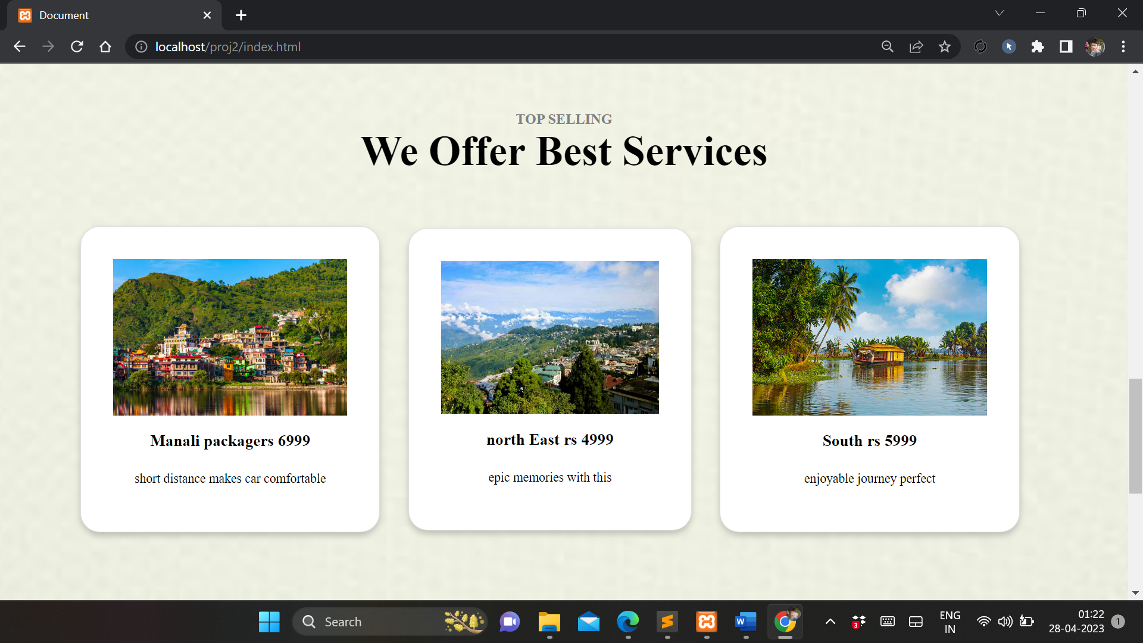
Travel SELECTION &FACILITIES

Slide 9
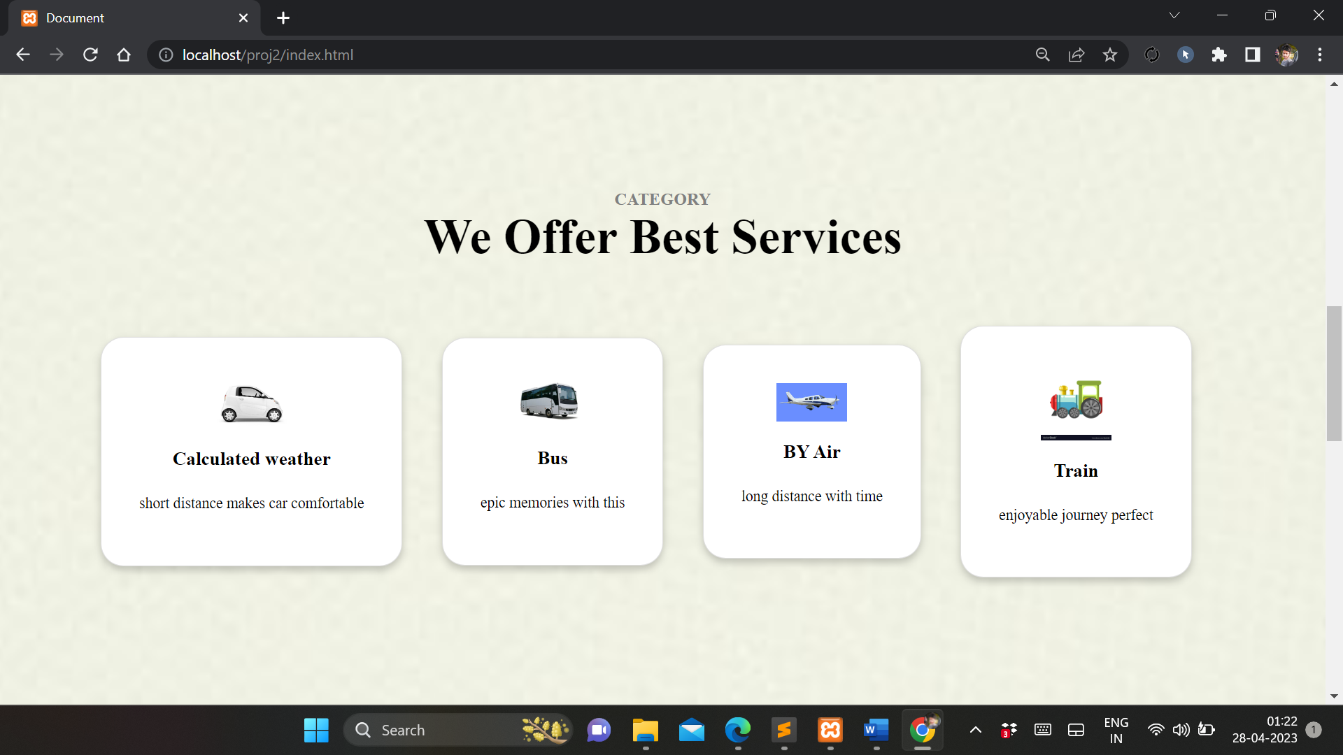
TRANSPORT CHECK PAGE

Slide 10
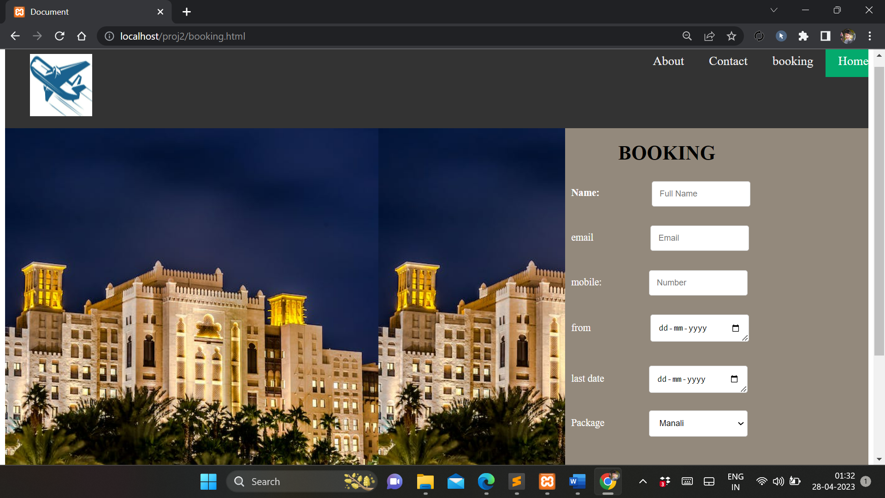
BOOKING PAGE

Slide 11
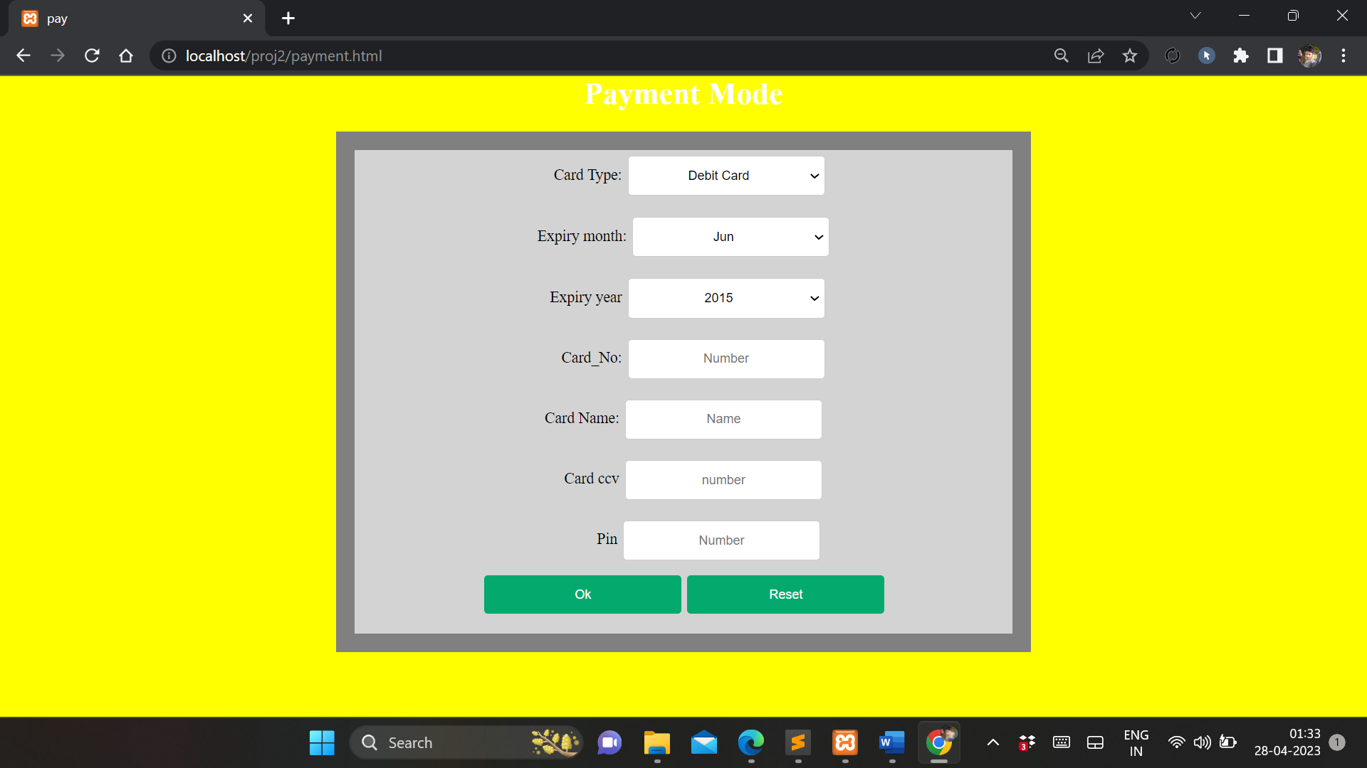
PAYMENT PAGE

Slide 12
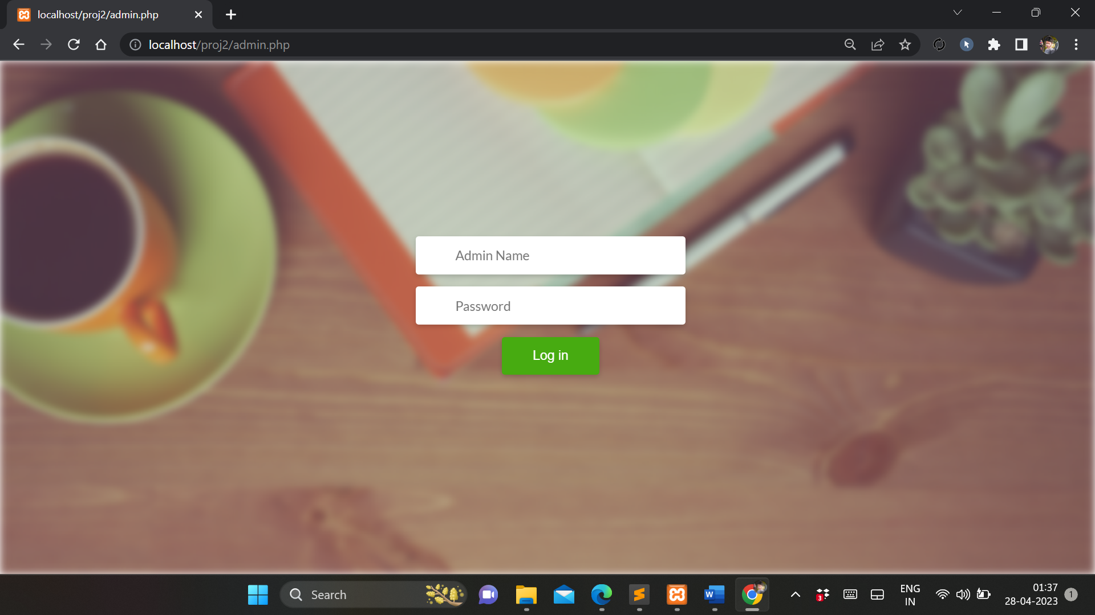
ADMIN PAGE

Slide 13
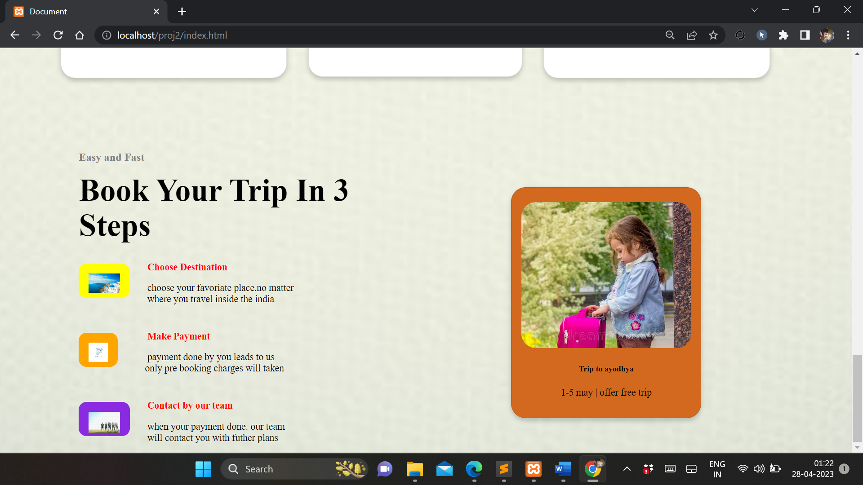
PROCESS OF BOOKING

Slide 14


